Slide 1
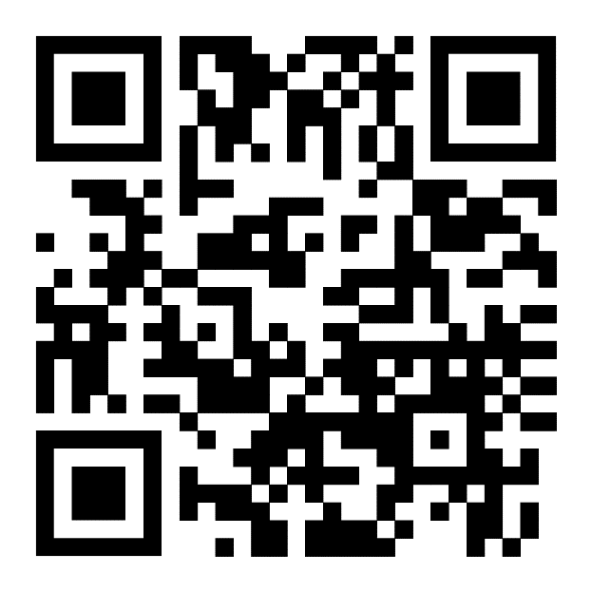
Electrical engineering computer engineering PURDUE FORT WAYNE
Guoping Wang, Ph.D. Chair
Department of Electrical and Computer Engineering
Email: wang32@pfw.edu
pfw.edu/ece

Slide 2
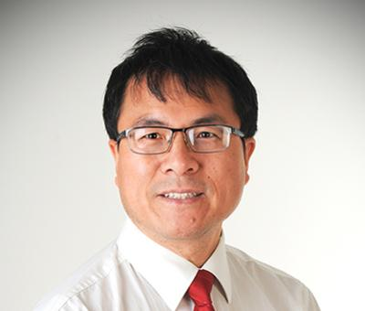
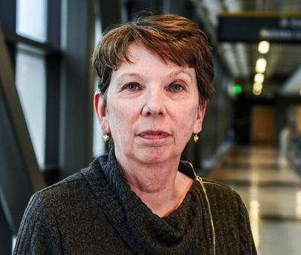
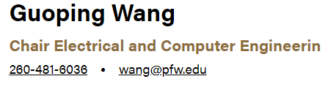
ECE CHAIR, senior ADMIN ASSISTANT, academic advisor
Kathy Pifko
Administrative Assistant
260-481-6362 kpifko@pfw.edu
Avi Goltz
Academic Advisor
260-481-6912 agoltz@pfw.edu

Slide 3
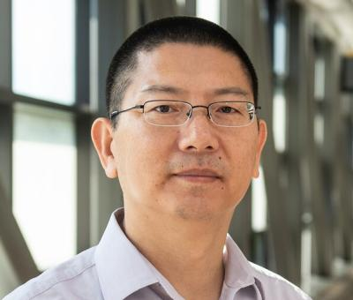
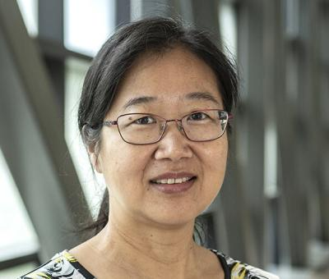
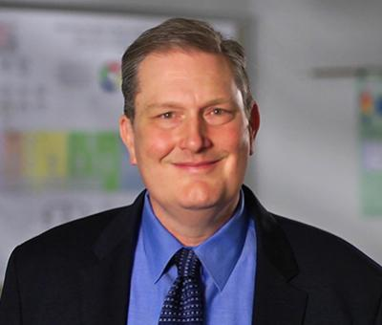
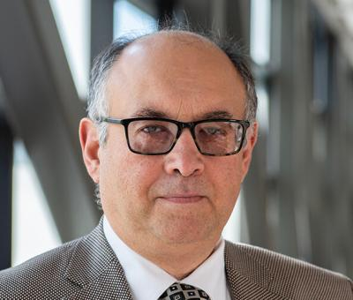
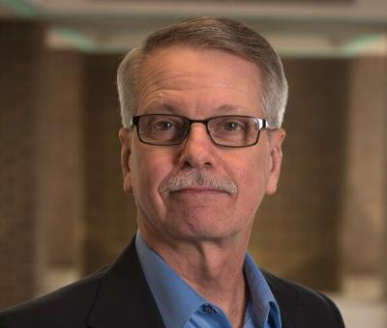
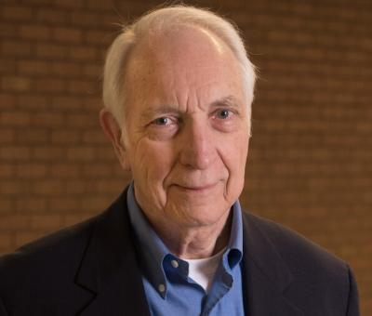
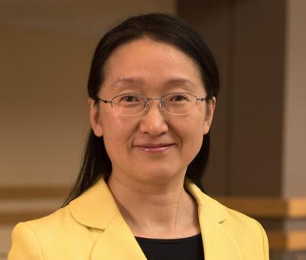
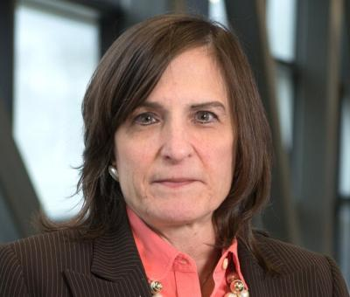
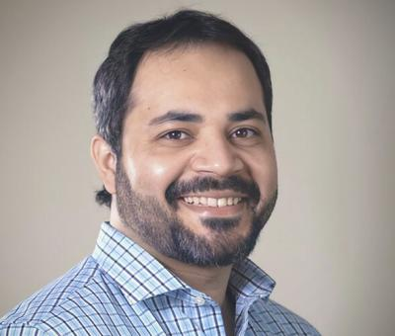
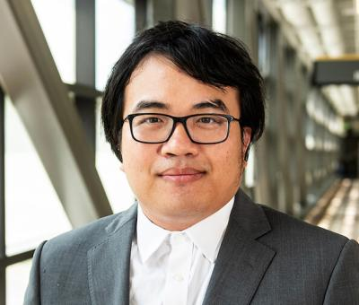
ECE faculty
Dr. Bin Chen Dr. Chao Chen Dr. D. Cochran Dr. T. Cooklev Dr. Perry Falk Dr. Jim Isaacs
Mr. O’Shaughnessey
Mr. Reidenbach
Dr. Ed Lyvers
Mr. Westrick
Mr. Keith Hood
Dr. Yanfei Liu Dr. E. Thompson Dr. C. Freitas Dr. A. Wang

Slide 4
Electrical and computer engineering
Electrical engineering is a little more focused on control, signal processing, power electronics, electromagnetic.
Youtube video, what is electrical engineering?
Computer Engineering is a little more focused on computer software and hardware system.
Youtube video, what is computer engineering?
Youtube video: Inside Computer Engineering

Slide 5
Computer Engineering vs Computer Science
Computer science focuses mostly on troubleshooting issues on a software level. Expect to learn different programming languages, how to work with operating systems, and how to maintain databases.
Computer engineering focuses on solving problems and designing hardware and software interfaces. Expect some similarities between the degrees and job titles, since computer engineers can be responsible for the development and prototyping of software and hardware simultaneously.
Notes:
While these computer science and computer engineering degrees share similar courses and are both great choices for a strong technology career, there is a major difference to note.
https://www.northeastern.edu/graduate/blog/computer-science-vs-computer-engineering/

Slide 6
Computer engineering vs Computer Science (Cont)
Computer science: More focus on Software
Computer Engineering: More focus on hardware, combination of hardware and software.
Youtube video: Computer Engineering vs Computer Science

Slide 7
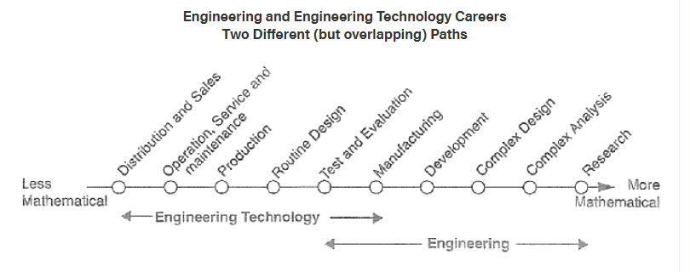
Engineering and Technology
Notes:
Engineering and engineering technology majors are concerned with the full range of technical issues from design, development & theory through construction & operation. However, the engineering majors place more emphasis on the advanced design, development, technical management and theoretical end of this spectrum; while engineering technology majors focus on the manufacturing, routine design, construction and operation end. Because of this difference the engineering majors requires a significantly higher level of training in mathematics. IPFW computer engineers majors earn a minor in mathematics automatically. IPFW civil, electrical, and mechanical engineering majors can earn a minor in mathematics by taking one additional mathematics course.

Slide 8
Careers for Electrical Engineers
Develop wind, solar, and traditional energy systems to help provide everyone in the world with electricity
Design controls and communications systems to help doctors perform surgery with smarter robots
Enhance image processing and make better instruments to help diagnose and treat diseases

Slide 9
Careers for Electrical Engineers (cont)
Design computer circuits to help speed up networks and processors that run your smartphone and other electronics
Improve batteries that help power equipment for soldiers and run electric-powered cars
Develop manufacturing, construction and installation standards
Direct the manufacturing, installation and testing of electrical equipment
Youtube video: What can you really do as an Electrical Engineer?

Slide 10
Title: Electrical Engineering
Electrical Engineer
Electronics Engineer
Embedded Systems Engineer
Hardware Engineer
Firmware Engineer
Power Systems Engineer
Controls Engineer
Automation Engineer
Systems Engineer
Test Engineer
Field Engineer
Manufacturing Engineer
Quality Engineer
RF Engineer
Applications Engineer

Slide 11
Careers for Computer Engineers
Embedded Computer Engineer
Engineer in Signal Processing and Image processing
Industrial Control, Testing and Measurement
Robotic Engineer
Design Implement an Internet of Things network to fast, efficient network
Implement and Design a Machine Learning network to make things smarter.
Youtube video: Computer Engineering Careers

Slide 12
Title: Computer Engineering
Computer Engineer
Software Engineer
Embedded Systems Engineer
Firmware Engineer
Hardware Engineer
Systems Engineer
Computer Systems Engineer
Embedded Software Engineer
Application Software Engineer
Test Engineer
Validation Engineer
Controls Software Engineer
Network Engineer
DevOps Engineer

Slide 13
Electrical and computer engineering at PFW
Bachelor of Science in Engineering with Major of Electrical Engineering (BSE-EE), Computer Engineering (BSE-CPE)
Double Major in BSE-EE/BSE-CPE (three to four extra courses)
MSE (Master of Science in Engineering) in Electrical/Computer/Systems Engineering
4+1 combined BS/MSE degree programs
Minors in Math/Computer Science/Physics

Slide 14

ECE Curriculum Structure
Design
Project
Engineering Science
Courses and Labs
Foundation Courses
Math, Science, Communications, Gen Ed, and
Engineering Fundamentals
Technical Electives
Engineering Applications
Co-op or
Internship
Undergraduate
Research
Technical Elective Group 2

Slide 15
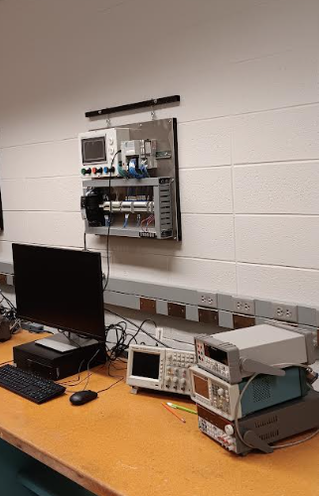
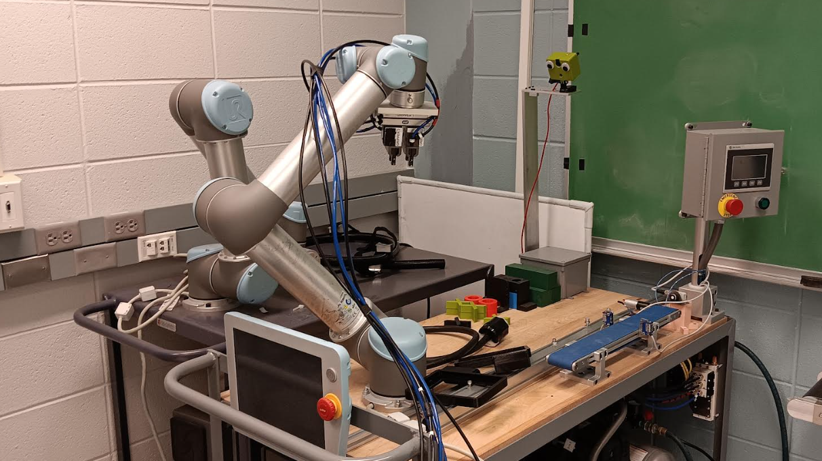
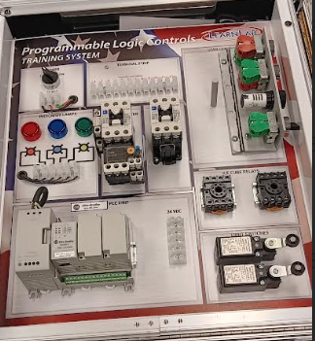
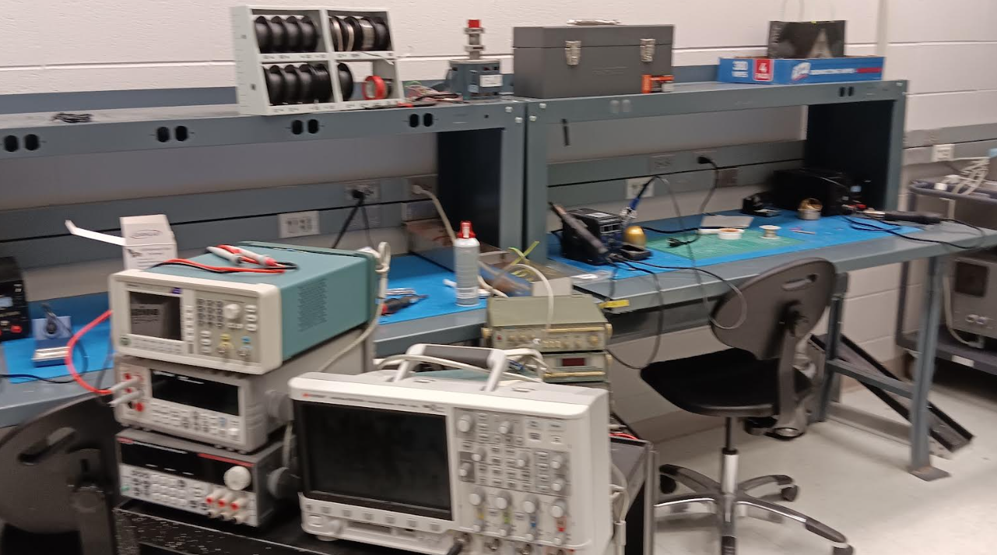
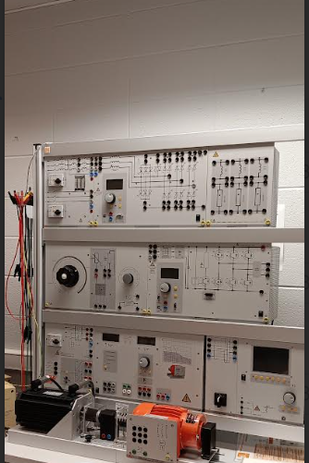
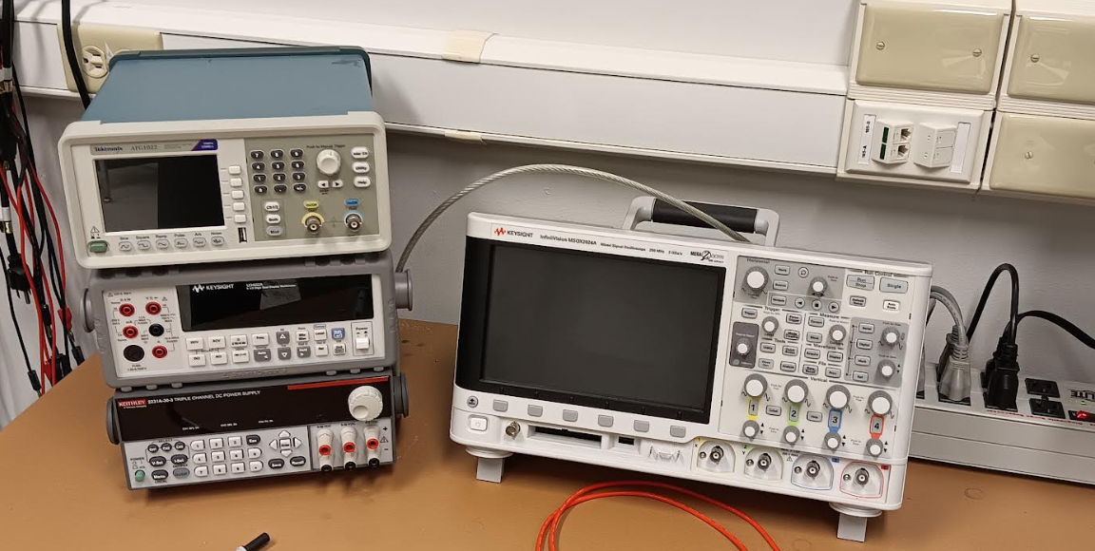
ECE Labs

Slide 16
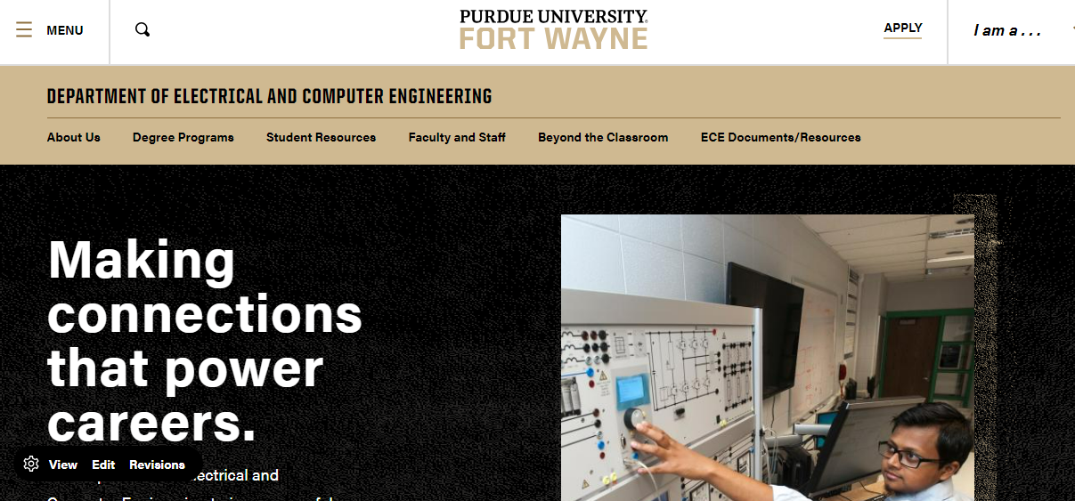
pfw.edu/ece

Slide 17
What we can offer
Electrical Engineering BSE-EE.
Computer Engineering BSE-CPE
Dual degree of Electrical Engineering & Computer Engineering
Major and Minor in Math
Minor in Computer Science
5-yr combined B.S. and M.S.E. degree
M.S.E. degree program

Slide 18
Electrical/Computer Engineering Curriculum
Bingo sheet, EE, CPE
General Education courses (B5 and B6)
Technical Electives (Groups 1 and 2), EE, CPE

Slide 19
ECE Program Standing vs PFW Standing
Only relevant courses, i.e. in the bingo sheet, are used in this determination of your program standing, specifically:
90 credits = Senior (before fall 2023)
90 credits (including ECE 36200) = Senior (after fall 2023 students admitted)
60 credits = Junior
30 credits (including PHYS 15200) = Sophomore

Slide 20
Difference between ECE Program Standing vs PFW Standing
Only ECE program standing in sophomore above are eligible for Co-op.
ECE 40500 – Senior Design I, students only in senior program standing are eligible to take it.

Slide 21
ECE Co-Op & Internship
Co-op, short for cooperative education, is a program that balances classroom theory with periods of practical, hands-on experience prior to graduation. Through the co-op program, students are able to alternate academic study with full-time employment, gaining practical experience in their field of study.
Academic Internship: Students will be working at least half-time and can still be a full-time student. However, we strongly advise students not to take many credit hours as a full-time student.

Slide 22
ECE Co-Op & Internship Opportunity
Our co-op industrial partners: Regal Nexnord, Nidec, GM, L&W Engineering, Raytheon, L3Harris, etc. and many others. Any industrials can participate in PFW ECE co-op program and internship program.

Slide 23


Institute of Electrical and Electronic Engineers www.ieee.org
The worlds largest technical professional society, with a worldwide membership of more than 400,000 electrical, electronics, computer engineers and computer scientists in approximately 160 countries.
IEEE mission: IEEE’s core purpose is to foster technological innovation and excellence for the benefit of humanity.
IEEE and its members inspire a global community through IEEE’s highly cited publications, conferences, technology standards, and professional and educational activities.
IEEE PFW Student Chapter - http://www.etcs.pfw.edu/~ieee/

Slide 24
Activities
Professional talk
Plant tour – BAE systems, Raytheon, QSC
Career talk

Slide 25
Society of Women Engineers
Purdue University Fort Wayne
Opportunity Fair
Picnic

Slide 26
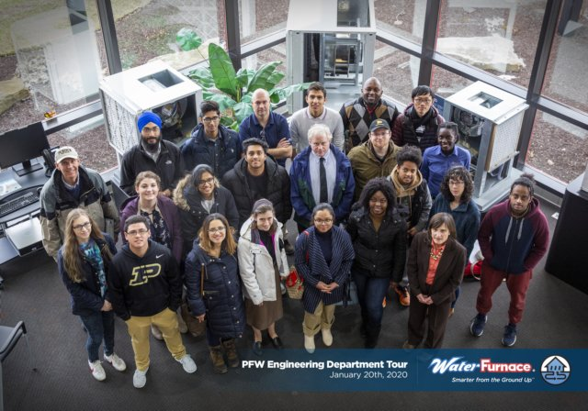
Water Furnace Plant Tour

Slide 27
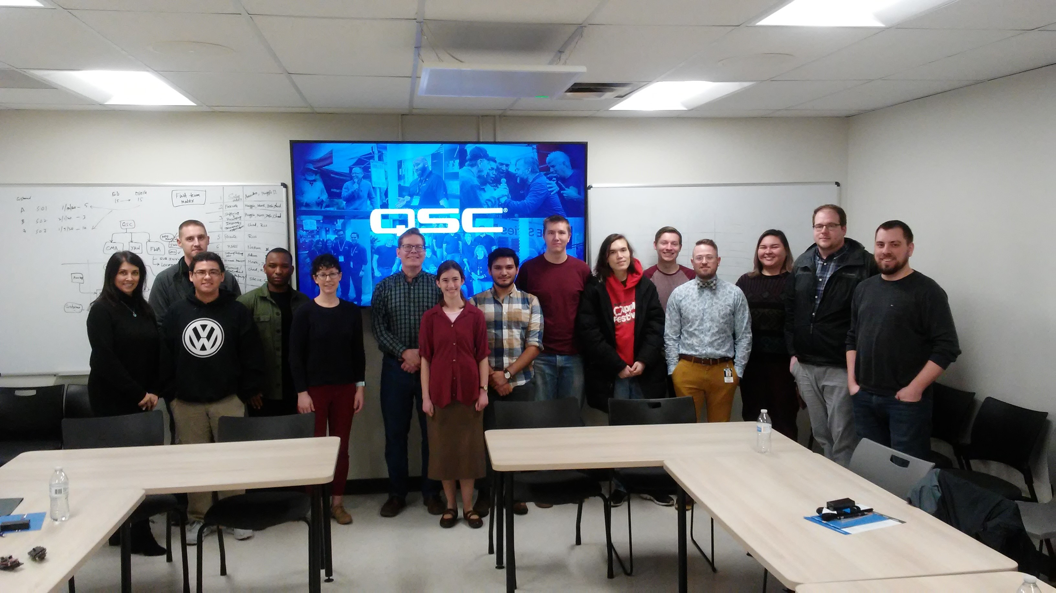
QSC Plant Tour

Slide 28


SWE Picnic

Slide 29
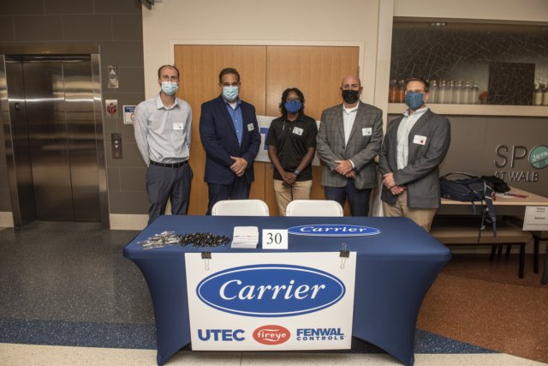
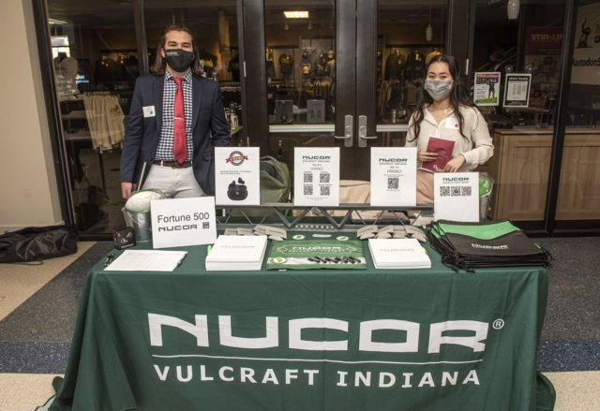
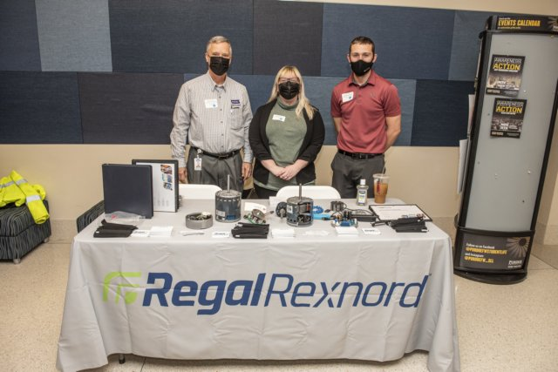
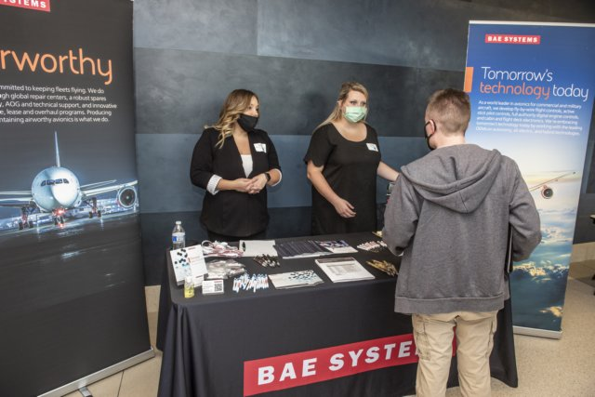
2021 Opportunity Fair

Slide 30
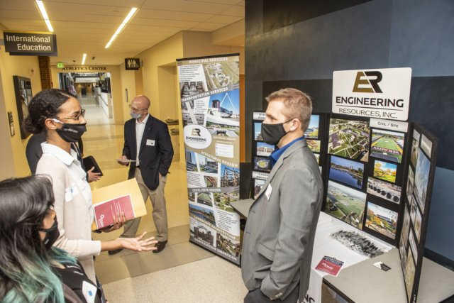
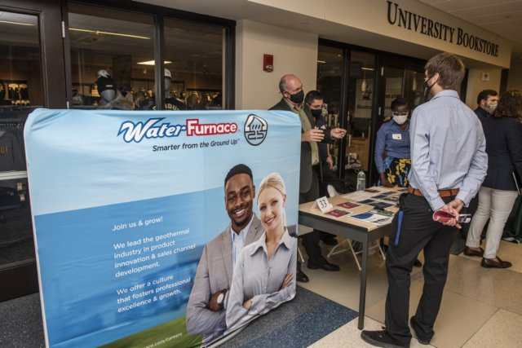
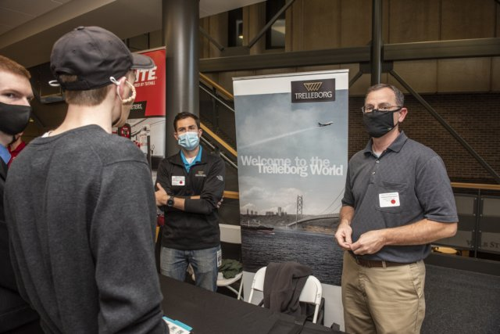
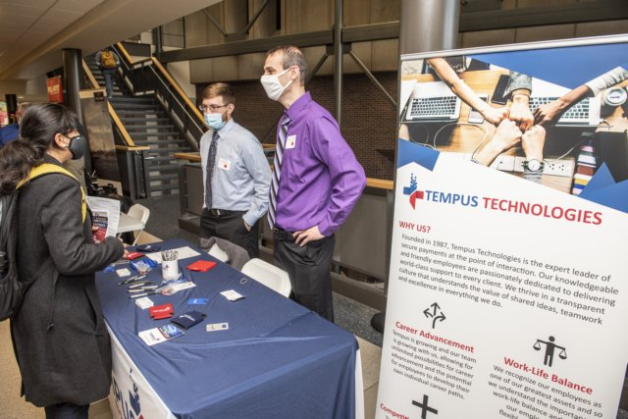
2021 Opportunity Fair Pic

Slide 31
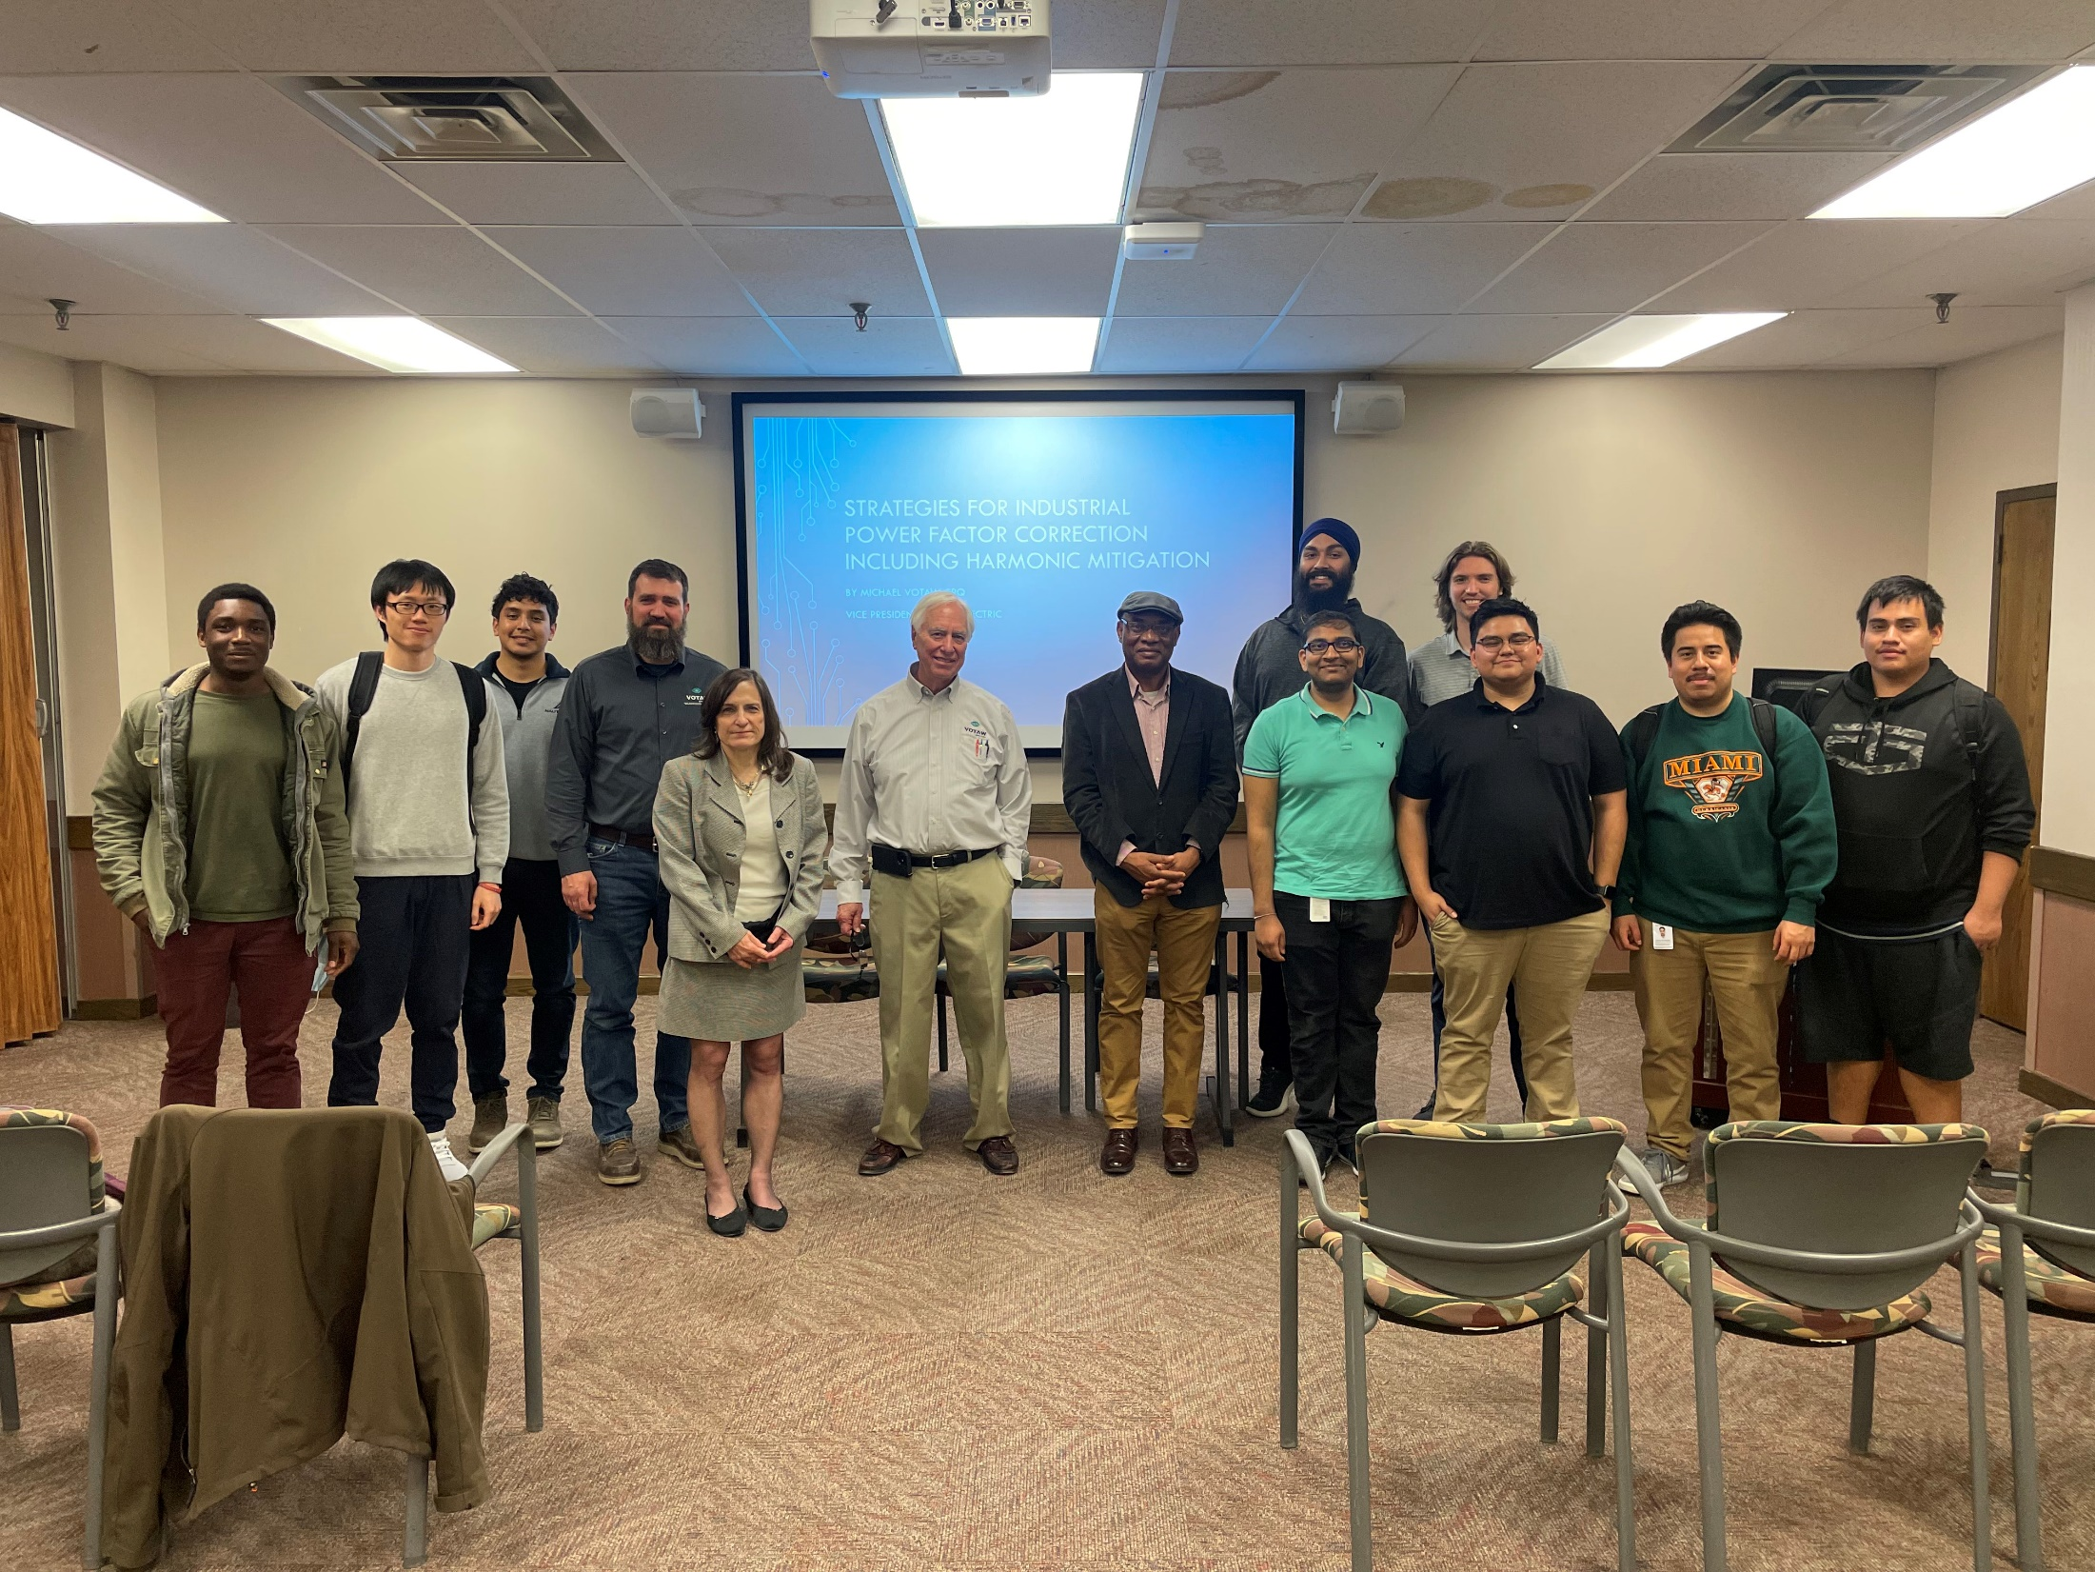
2022 ECE Guest Talk

Slide 32
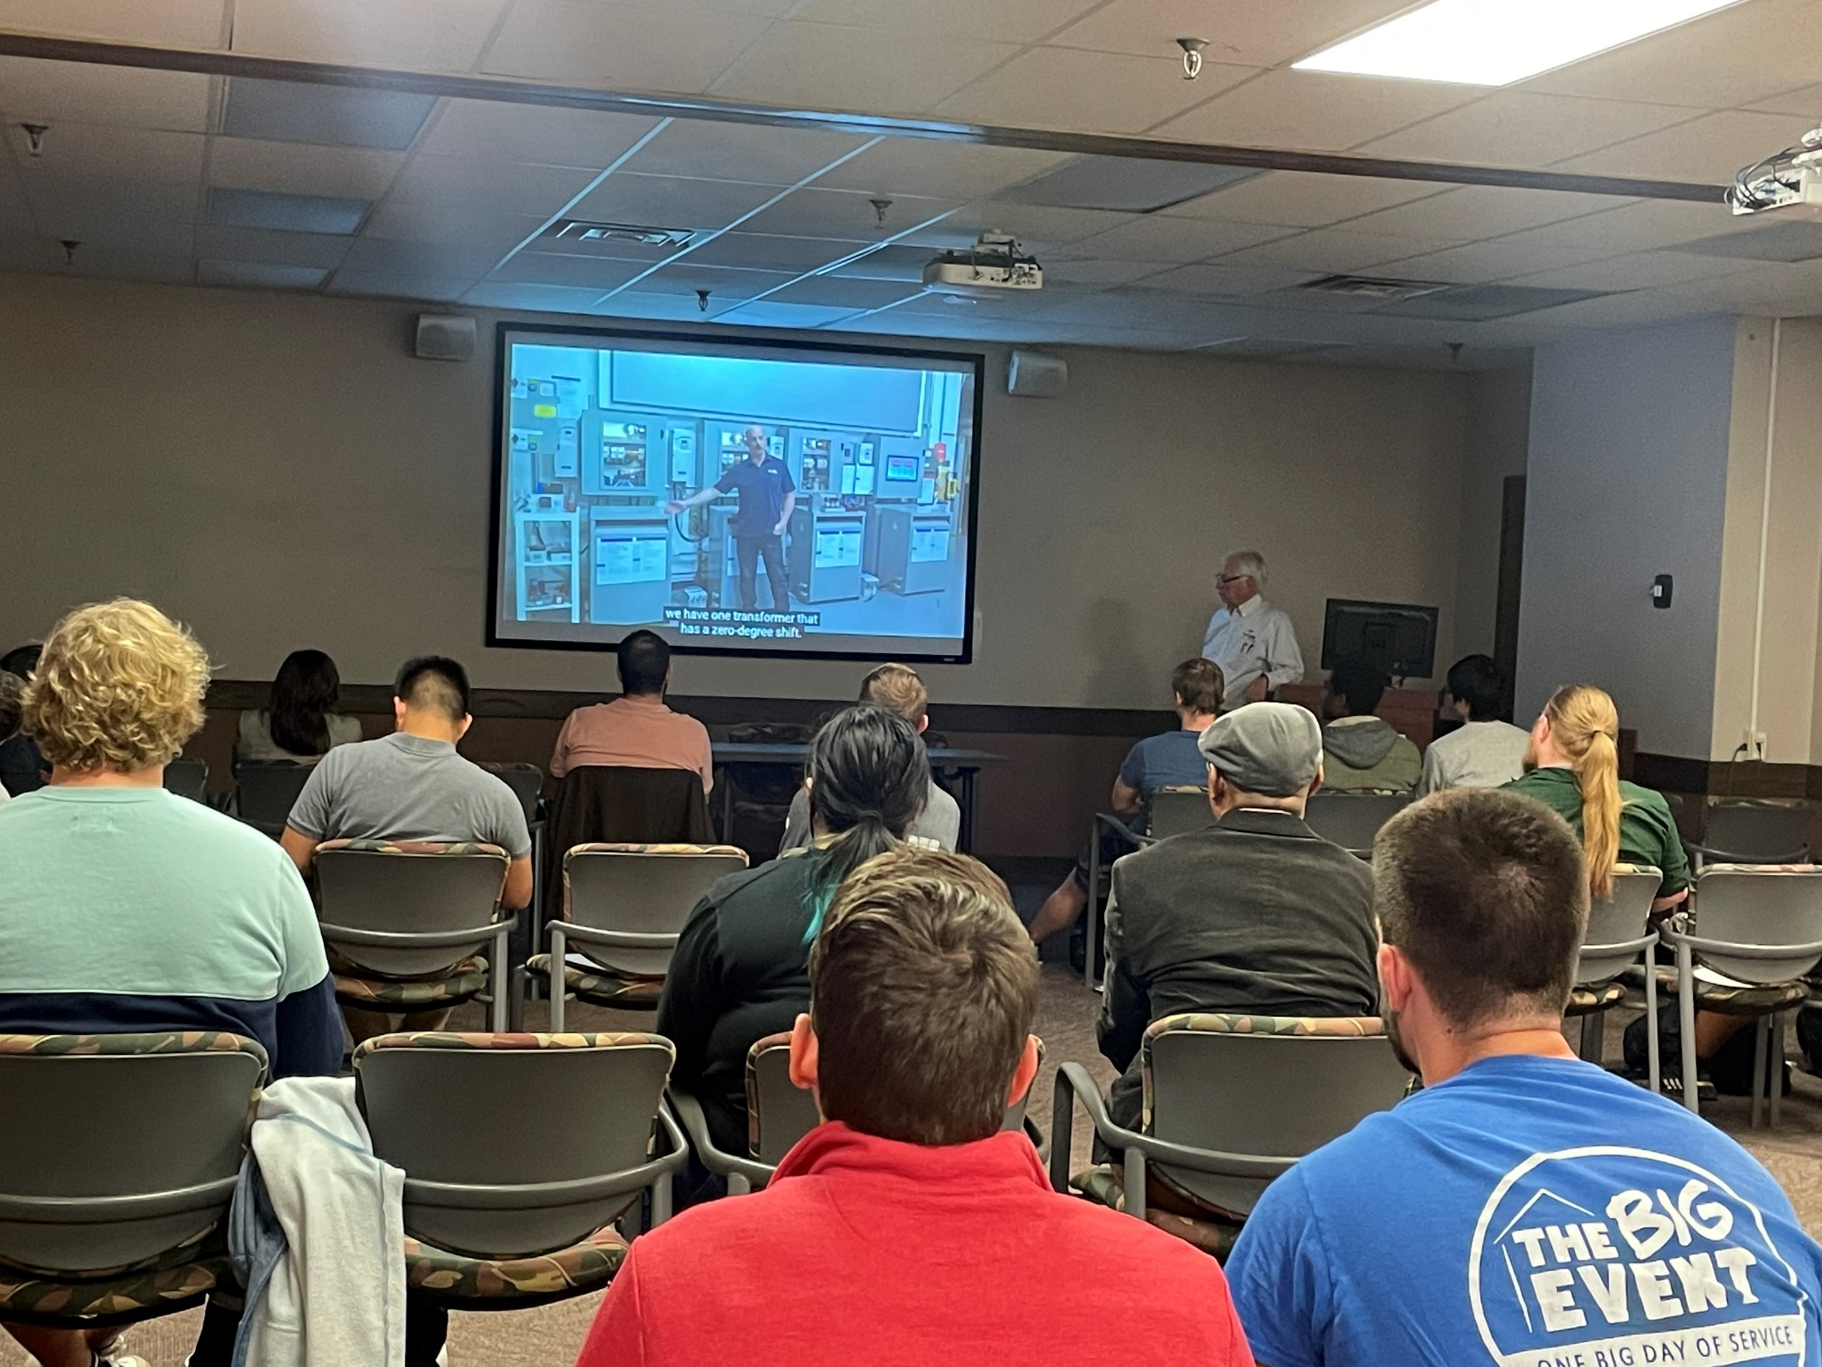
2022 ECE Guest Talk Pic

Slide 33
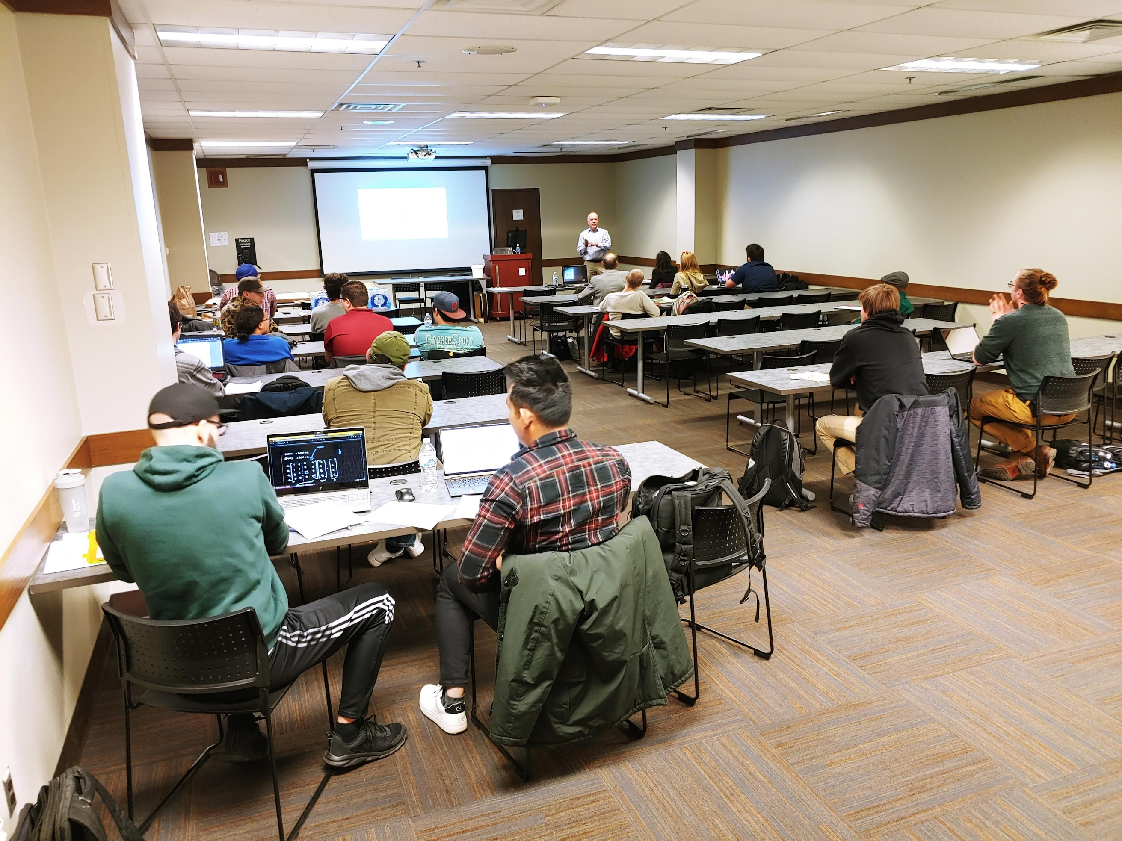
2023 ECE Guest Talk

Slide 34
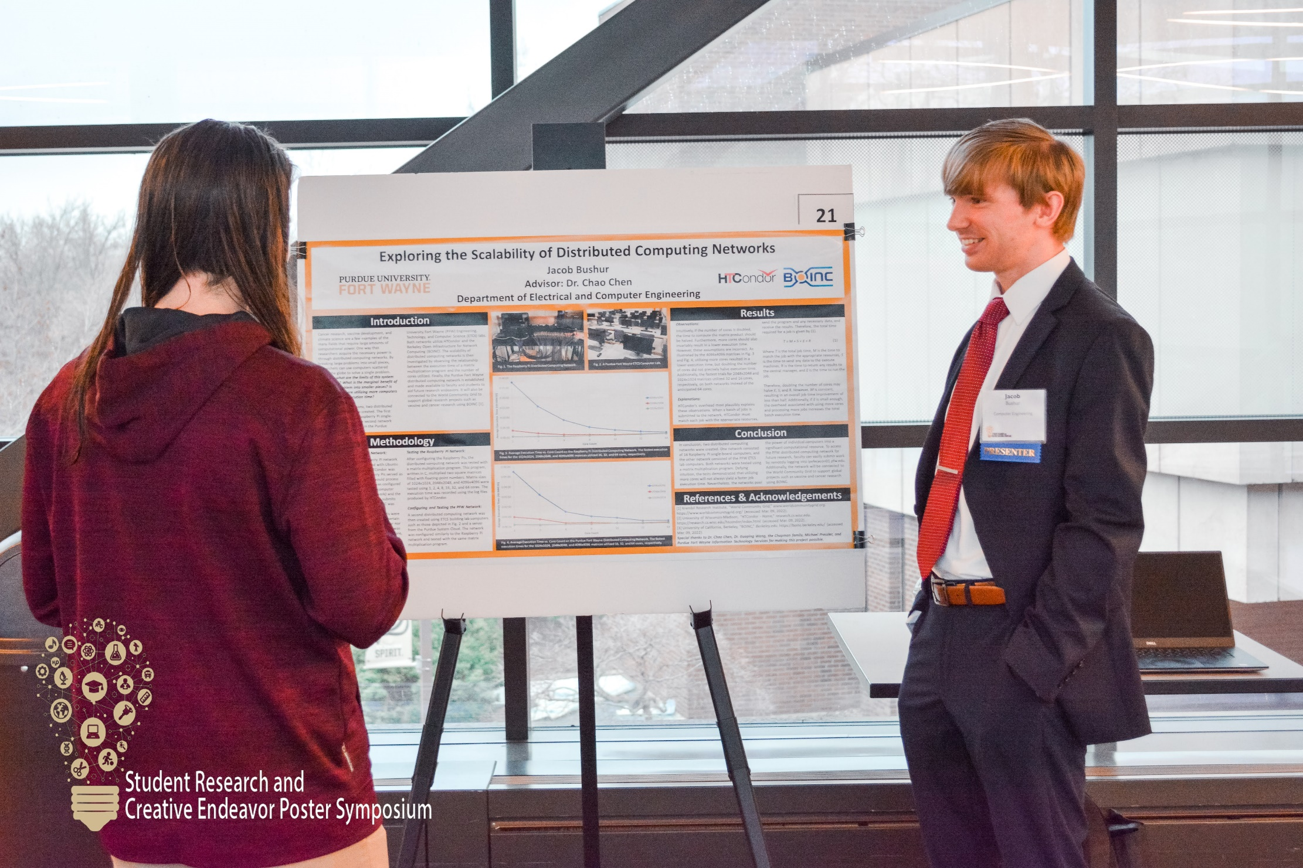
2023 Research Symposium

Slide 35
Resources
ETCS LEAD Program
ETCS Help Center – Tutoring
University Tutor
pfw.edu/ece - most department-related questions.

