Slide 1
A Cost-Effective Long-Distance IIoT System
Guoping Wang, Ph.D.
Department of Electrical and Computer Engineering
Purdue University Fort Wayne

Slide 2
Outline
Introduction of IoT
LoRa, LoRaWAN and its constraints
Problem Statement
Implementation
Summary

Slide 3
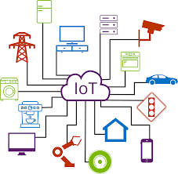
IoT Introduction
The Internet of Things (IoT) is the inter-networking of physical devices, vehicles (also referred to as "connected devices" and "smart devices"), buildings, and other items—embedded with electronics, software, sensors, actuators, and network connectivity that enable these objects to collect and exchange data. IoT allows objects to be controlled and gather information remotely across the already established network.

Slide 4
LoRa, LoRaWAN
LoRa (Long Range) – a modulation technology for low-power, wireless wide area networks on unlicensed radio frequency bands over long distance.
LoRaWAN (LoRa wide area network) is a network protocol on top of LoRa technology in star topology where multiple end devices communicate with one or more gateways, consisting of end nodes, LoRa gateway, LoRa server and application server.

Slide 5
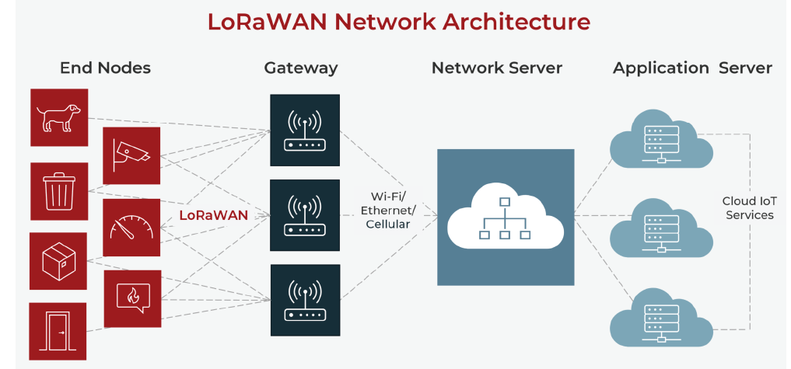
LoRaWAN Network Architecture

Slide 6
LoRaWAN Limitations
Limited Bandwidth: LoRa has limited bandwidth compared to other wireless technologies like Wi-Fi or cellular networks. This limits the amount of data that can be transmitted at a given time. In Europe, duty cycle is limited to 1%, FCC – 400ms max dwell time per channel.
Interference: LoRa operates in the unlicensed ISM bands, which can be crowded and prone to interference from other devices using the same frequencies.
Limited Data Rate: LoRaWAN does have a limited data rate compared to other wireless technologies. This makes it less suitable for applications that require high data transfer speeds.

Slide 7
LoRaWAN Limitations
Latency: LoRa is optimized for low power consumption, which can lead to higher latency compared to other wireless technologies. This makes it less suitable for real-time applications that require immediate data transmission.
Reliability: LoRa is designed to be robust against interference and fading, but in some environments, such as urban areas with a lot of obstacles, the reliability of the communication link can be reduced.
Regulatory Restrictions: LoRa operates in the unlicensed ISM bands, which are subject to regulatory restrictions in different countries. Compliance with these regulations can add complexity to deploying LoRa networks.

Slide 8
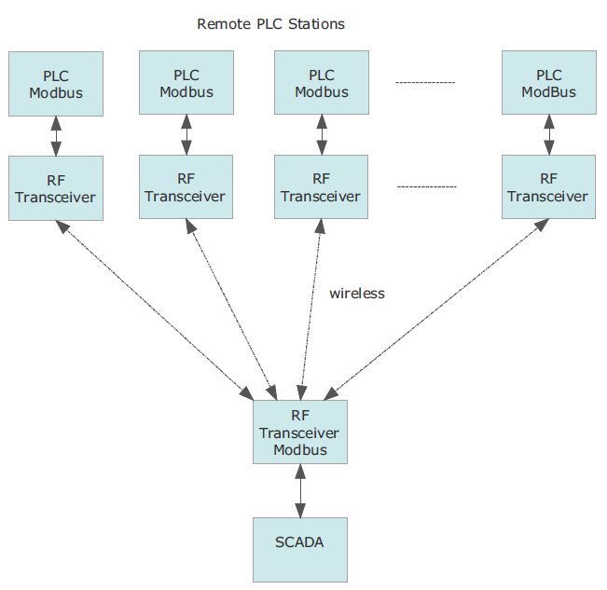
BACKGROUND
Sensors from 20 Remote PLC stations transmitted to a SCADA server.
Current system: ModBUS through polling between SCADA server and each node, it takes 20 minutes to get all 20 stations data back to the server.

Slide 9
Problem Statement
Cost-effective: The cost of the proposed system should be minimized.
No annual/monthly subscription: The proposed system should not require annual or monthly subscription fees from any Cloud service providers.
Interface: The system should be easy to interface with the Ignition SCADA system through the MQTT/Sparkplug B protocol.
Reusability: Though it is a requirement, if possible, the current RF transmitter and receiver can be reused.
Real-time: if possible, maximum 5 minutes to sample all 20 PLC station sensors to the server.

Slide 10
Updated IIoT System
Architecture: around 20 remote sensor nodes, pairs of RF transceivers, MQTT/Sparkplug B publisher and the Ignition SCADA system
For one-way data transmission from approximately 20 sensor nodes to one receiver, through one RF frequency, a time-sharing multiplexing approach can be employed. Each sensor node has a GPS module that provides precise time, allowing 20 sensor nodes to send data at precise time intervals. The implemented system takes 10 seconds for one PLC sensor node, for 20 stations, the cycle time is 20*10 = 200 seconds <= 5 minutes

Slide 11
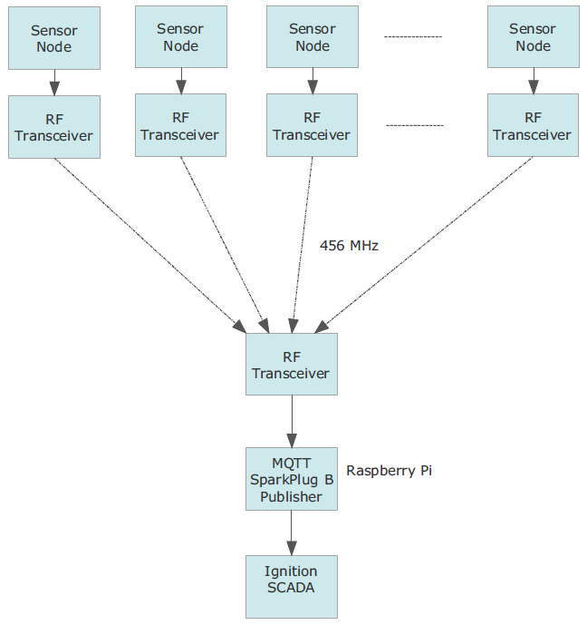
Improved IIoT System

Slide 12
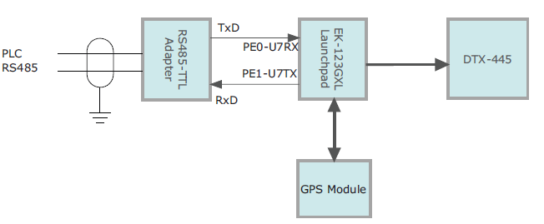
Sensor Node

Slide 13
Sensor Node Hardware
DTX-445: an analog telemetry transceiver for long-range wireless sensor monitoring and control, working at one licensed 456 Mhz RF frequency.
TI EK-TM4C123GXL Launchpad: a powerful Cortex M4 MCU supports UART, SPI, I2C and easy interface PLC stations and a GPS module.
GPS Module: BN-880 GPS module, with interface of TTL or RS-232, easy to interface to MCU and provides a coordination and real-time information
RS-485 TTL adapter module: The PLC station interfaces to the MCU through a RS-485 adapter (RS-485 to RS-232). RS485 allows the communication over long distance (up to 4000 feet) from the PLC station to the MCU.

Slide 14
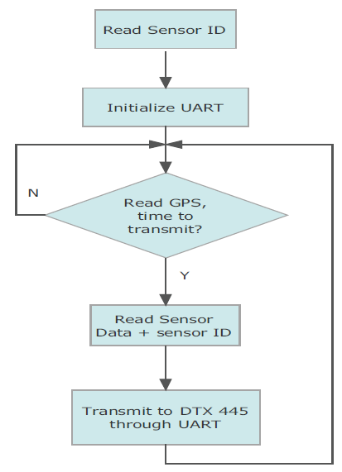
Sensor Node Software
the UART ports and GPS module are initialized. Then, an endless loop is executed. If the sensor data is received, the TI Launchpad extracts the information and packs it into a payload with the station ID, which is then transmitted through the DTX-445 transceiver at a specified time, calibrated through the GPS module. Usually, GPS modules decode these GPS signals, which include precise time, effectively synchronizing each receiver to atomic clocks. This enables the end node to determine the time to within 100 billionths of a second, without the cost of owning and operating atomic clocks.

Slide 15
IIoT Receiver Hardware
The receiver consists of one DTX-445 transceiver, and one Raspberry Pi 4.
Raspberry Pi 4 is a series of small, affordable, and versatile single-board computers, with Linux preinstalled, Sparkplug/B package installed. It is capable of performing many of the functions with the rich support of Python libraries.
Sparkplug B is an IIOT standard for communication.

Slide 16
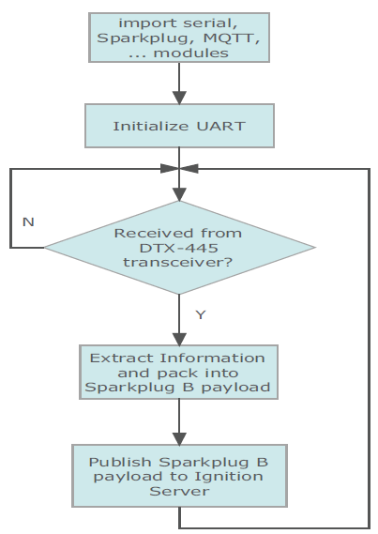
IIoT Receiver Software
Sparkplug, MQTT, PySerial, and other Python modules will be imported when started. Then, the UART ports are initialized. An endless loop is executed. If a station payload is received from the DTX-445 transceiver, the data about the sensor node is extracted and combined with other Sparkplug B information to create a Sparkplug B payload. This Sparkplug B payload will be sent to the Ignition engine for processing through WiFi, or wired Ethernet.

Slide 17
Ignition SCADA
Ignition SCADA (Supervisory Control and Data Acquisition) is a powerful industrial automation software platform developed by Inductive Automation. It is designed to provide a comprehensive solution for monitoring, controlling, and analyzing industrial processes in real-time.
Ignition SCADA offers a wide range of features, including data acquisition from various sources such as sensors, PLCs (Programmable Logic Controllers), and databases, as well as visualization tools for creating dynamic and customizable HMI (Human Machine Interface) screens. O
Modules: Ignition MQTT distributor, MQTT engine, Ignition Designer, Ignition gateway, etc.

Slide 18
Summary
In this paper, we have introduced an IIoT system with strong ability of anti-interference, long-range and relatively cost-effective, even when there is not a good line of sight between sensor nodes and the receiver. This proposed IIoT system consists of GPS-equipped sensor nodes, one-channel RF transceivers, a MQTT/Sparkplug B publisher, and the Ignition SCADA system. The detailed designs of both hardware and software systems are covered. This proposed system provides a viable solution when LoRa technology may not be a good option.
Notes:
Changed from constraints to given params due to already having a constraints and limitations slide - Sam

Slide 19
Questions?
Notes:
Sam

