Slide 1
Introduction To The P: Drive
By B.W

Slide 2
What is the P:Drive?
Always-live storage drive, hosted by university
  HTTPS authenticated and signed .edu domain
Designed for static web content (JS, Html, CSS)
From perspective of PFW network, a standard file drive

Slide 3
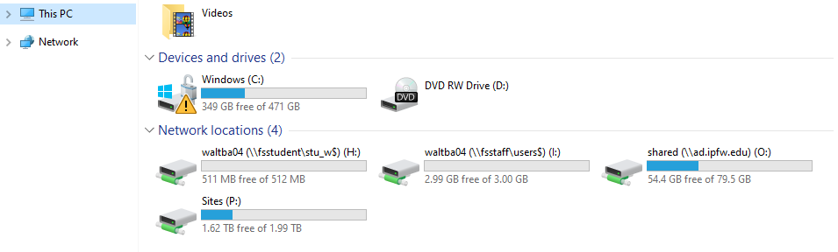
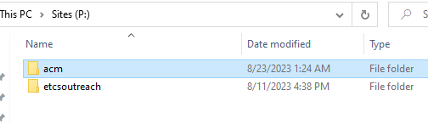
Accessing the P:Drive
Connect to PFW/Purdue internal network (or VPN)
  Navigate to “This PC”
    Under Network locations, find the drive “Sites (P:)”
    This is the P:Drive
P:Drive acts as normal storage location, however ALL content is PUBLIC and LIVE.
  Can be indexed by search engines (we can use this)
  Can host arbitrary static media
We store files under the “acm” folder. Respect this.

Slide 4
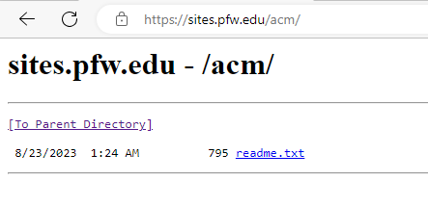
Drive Function
By default, the drive performs a basic file serve of the target file
  If the target is a directory, the server:
    Searches for an “index.html” which it serves if found
    If not found, serves an autogenerated link-directory of the subfiles
  If the target is a file, the server:
    Serves the file
Site content is hosted at https://sites.pfw.edu/, in our case https://sites.pfw.edu/acm/

Slide 5
Basic Drive Rules
Respect the PFW and ACM image online
Maintain a decent appearance and style
Only post content which can be safely and permissibly made public
Stay organized and clean
Ensure that it’s possible to navigate forward/backwards on the site
  This may mean not creating an index.html file if you cannot update it to contain all sublinks/files. This is perfectly fine, particularly for media collections (PDFs, Zips, etc;)
If doubtful of any of the above, speak with fellow OFFICERS and ADVISOR

Slide 6


Developing on The Drive – P1
Since P:Drive is both a file-drive and a server, html and media can be opened from the drive OR from the site-view.
  The views ARE different
  Sites have different CORS rules
  Sites do not handle filenames the same, ie double backslashes ”https://sites.pfw.edu/acm//test.html” has different effect than “P:/acm//test.html”
    This can affect links to other pages, or prevent certain requests from processing
  Files cannot perform many networking and loading events in the same way or capacity as sites can

Slide 7
Developing on The Drive – P2
Since P:Drive is both a file-drive and a server, content can be cached and/or loaded differently
  Browsers will cache things for sites, like JSON, CSS, and JS files loaded from other URLs
    They’ll reload these caches when state changes are made, such as changing filenames, or posting. It’s easier to just clear the cache in the browser
  Browsers will refuse to make certain requests or implement certain behaviors for files.
  It’s best to swap between views, frequently clearing your cache.

Slide 8
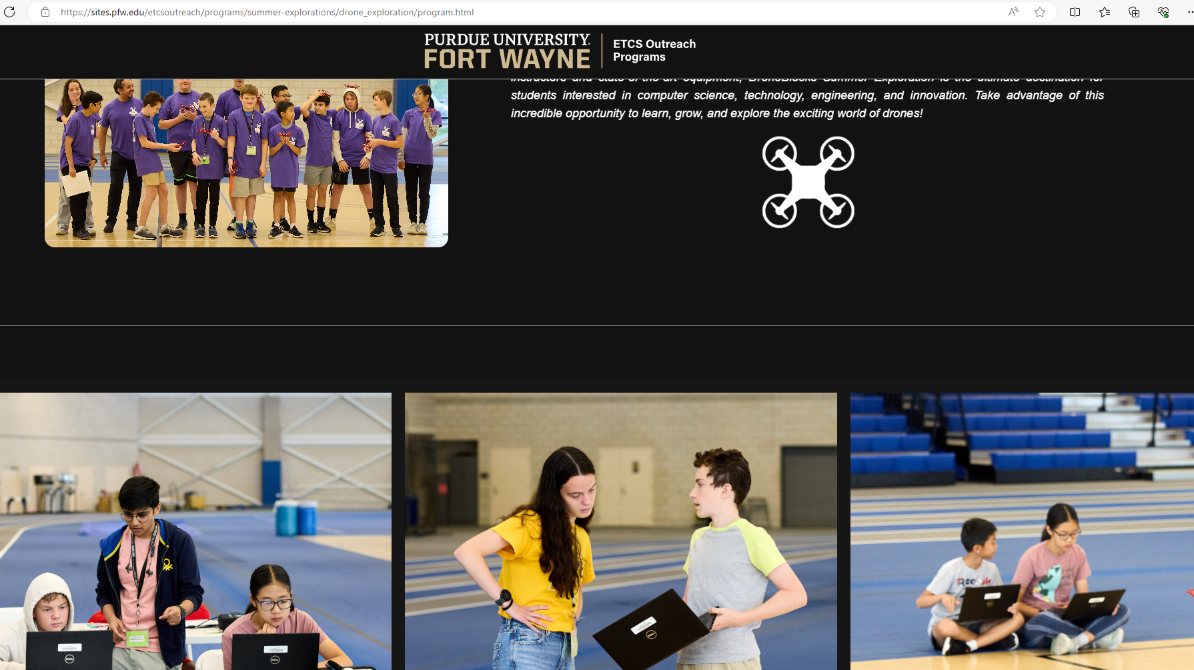
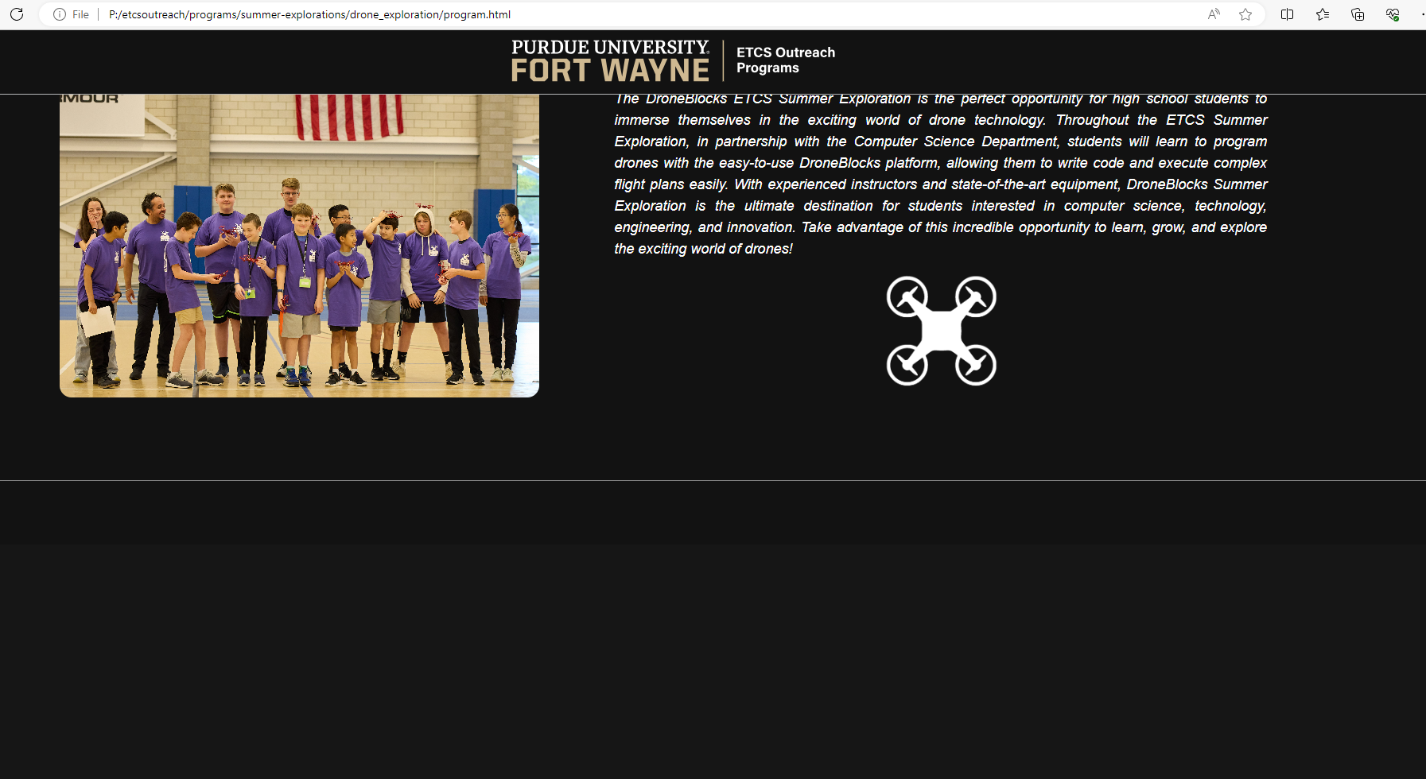
Example
One is loaded as site, the other as file.

Slide 9
Developing on The Drive – P3
University has its own set of font families which it uses for certain titles and paragraphs. The same is true of colors. These are included on the drive and linked below.
  CSS Web Fonts (w3schools.com)
  Visual Elements | Purdue University Fort Wayne (pfw.edu)
The preferred font load order is usually one of:
  [special font], Sans Serif, Arial
  Sans Serif, Arial
Load orders progress from left to right when the user doesn’t support or have a font.

Slide 10
Developing on The Drive – P4
PFW typically implements text-heavy pages as article-tags with div wrapped section-tags. This allows them to be reader friendly, and well organized.
It’s useful to separate commonly used clusters of css styling commands under a generic class, and give tags multiple classes in order of importance
  Ie: “class = ‘heavy center colorized-text’” rather than “class = ‘unique-text-class’”
A decent backend can be simulated by fetching resources from the server itself, or from online docs/sheets/json apps, then dynamically adding content.
While University guidelines are strongly advised, one of the benefits of the P:Drive comes with its freedom from a template structure.
  Maintaining a good image is a key aspect of maintaining this freedom.

