Slide 1

Censorship & Surveillance
By: Brian Waltz - ACM

Slide 2
What is censorship?

Slide 3
Censorship:
Suppression & Prohibition of media on the basis of it being
  Unwanted
  “Dangerous” or “Harmful”
  Sensitive
Can be
  Self Applied
  Government Enforced or Mandated
  Intentional Erasure & Ignorance
  Integrated/Adversarial
  Covert/Overt
Examples
  Refusing to acknowledge a subject
  Burning media related to a particular subject
  Punishing individuals who mention a subject
Can be “good” or “bad”

Slide 4
What is surveillance?

Slide 5
Surveillance:
Behavior monitoring & observation, information gathering. Elements of:
  Information control
  Efforts to influence or manage behaviors
Can be
  Self Inflicted/Externally Enforced
  Covert/Overt
  Direct/Indirect
  Integrated or Adversarial
Examples
  Asking someone to weaken their security for you
  Watching someone’s daily activities, logging them
  Observing and Analyzing someone’s friend group

Slide 6

Surveillance + censorship?
Often governments want both
  Often implementation of one is linked to the other
Modern Surveillance and Censorship share platforms & methods
  Social Media, Websites, Ads, Applications, Politics
Heavy use of one typically implies/enacts the other
  Mass Surveillance -> Censorship
  Effective Censorship Enforcement -> Mass Surveillance

Slide 7
Censorship & Surveillance
Control

Slide 8
Censorship & Surveillance require control
Require control to implement measures
01
Require control to enforce measures
02
Require control to either gain/force access, or gain/force cooperation
03

Slide 9
Control: Action Chains
Censorship & Surveillance both target actual actions
Actions are preceded by other actions, and followed by other actions. If these actions are related, they form a chain.
Action Chain – Set of ordered, related actions
  Censorship & Surveillance often target different stages of the same action chains
  Only need to target or control one step of a chain to effectively control it
Example: Publishing a Political Poster
  Make the Political Poster
  Request Approval from the Office of Posting & Media, providing the poster
  Give the OPM your Poster for Posting

Slide 10
Establishing Control
Integrated Methods
Adversarial Methods
Embedded into the action chain
  Often augment or add to an action chain, producing a new controlled chain
Often negotiated with parties involved in the chain
Requires intentional or unintentional implementation by involved parties
Used when control methods are unwanted, or actively deterred
Forceful
Often easier to accomplish secretly or subversively
Attack elements of action chains

Slide 11
Governments Target Everything
Conversation Chains
  Social Media
  Email
  Blogging
Encryption Chains
  Document Encryption
  Communication Verification
  Communication Encryption
Information Gathering Chains
  Websites & Online Resource Pools
  Social Media Posts & Influencers
Research and Development Chains
  New Communication Tools
  Publishing of R&D
  New Technologies

Slide 12
Censorship & Surveillance
Methodologies

Slide 13
Understanding ThE Internet
What is the Internet Browser’s Action Chain?
How are websites found?
How do we get information to and from servers?
How do we authenticate and identify ourselves?
What are Encryption Action Chains?
How does encryption work?

Slide 14
What is the Internet?
A network of computers that exchange information
  Some computers are authorized with or expected to perform important tasks
  There is often a path of computers between you and a website/service
  Computers communicate and negotiate using protocols
  Can be visualized as a social network
Notable Services and Protocols:
  IP – Internet Protocol (IP Address, such as 185.344.25.29, is the address of a computer on the internet)
  DNS – Domain Name Service (Used to find websites)
  CDNs – Content Delivery Networks (Used to improve media loading)
  TLS – Transport Layer Security (Commonly used for encryption)
  Cas – Certificate Authorities (Manage and approve TLS certificates)

Slide 15
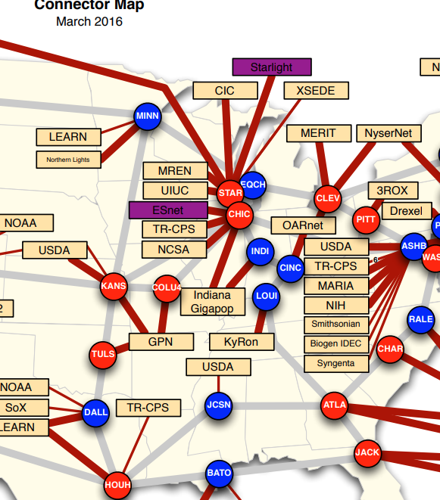
Internet Protocol
Your internet is provided by an ISP
  ISP must route your trffic within their network
  ISPs must route your traffic between themselves
  ISPs must route your tradffic to the global internet
  They must perform that in reverse as well
IP Address is the address to route to/from

Slide 16
DNS: Domain Name Service
Computers selected to have the responsibility of remembering which websites (names) associate with which IP addresses (devices/networks). We call this ‘resolution”
  Ie: Google.com resolves to 172.217.215.101
Must know the IP address of your intended DNS server
Any computer can offer this service, as long as it responds in protocol
DNS server and you MUST be able to communicate to enable resolution
Friend who knows everyone’s numbers

Slide 17
CDN: Content Delivery Network
A distributed set of computers responsible for saving frequently requested media for faster access.
Instead of a single central server providing all files, ANY computer within a CDN network can respond.
Provide ‘caches’ of resources – local copies they were instructed to save
Friend who remembers everything

Slide 18
TLS & CAs
Encryption agreed on by two parties, used for all communications after a handshake, using a TLS certificate
Attackable, but hard for current computers (intensive math)
Certificate Authorities sign TLS certificates
  Helps ensure they are who they claim to be
Anyone can be a CA – Devices come with a preapproved list

Slide 19
Attacks?

Slide 20
DNS Poisoning
Poison the servers that provide addresses, or alter the information they’re sending and receiving.

Slide 21
Cache Poisoning
Poison copies of websites or data being distributed

Slide 22
MiTM Attack
Man-in-the-middle attacks target a communication chain. Attacker inserts themselves between two communicating devices.

Slide 23
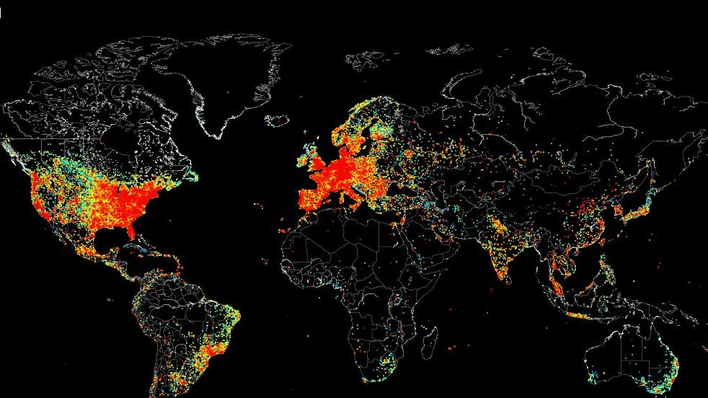
Restrictive Firewalls
Restrict which connections are valid and possible in and out of a sub-network
Allow for network inspection at the ‘packet’ level
Can be tailored to regime interests

Slide 24
Metadata Analysis
Metadata – Data about data, such as who liked a post, who the author is, the date, the media type, etc;

Slide 25
Wifi Positioning SYstems
Get position based on nearby Bluetooth devices, Wifi networks, and network performance

Slide 26
Surveillance Capitalism
Absorbs information from websites, social media, company sales, pharmaceutical systems, healthcare systems, etc; that companies sell
Much of the information that previously required programs like PRISM is now openly sold

Slide 27
Lateral Integration
Combining as many of the previous methods as possible to enhance collected info
Data Pipelines

Slide 28
Current Examples
https://truthout.org/articles/report-ice-is-expanding-surveillance-of-its-critics-on-social-media/
https://www.nytimes.com/2025/02/02/upshot/trump-government-websites-missing-pages.html
https://www.forbes.com/sites/emmawoollacott/2025/02/27/us-govt-demands-millions-of-google-apple-and-meta-user-accounts/
https://arstechnica.com/gadgets/2025/03/italian-court-orders-google-to-block-iptv-pirate-sites-at-dns-level/

Slide 29
Sources
https://witestlab.poly.edu/blog/a-peek-into-internet-routing/
The Art Of CYBERWARFARE: An Investigat‘s Guide to Espionage, Ransomware, and Organized Cybercrime by Jon DiMaggio
Research by OONI, The CitizenLab, OutRight International

